Slide 1
Global Indexes
Community Power

Slide 2
US500 v5
Exness

Slide 3
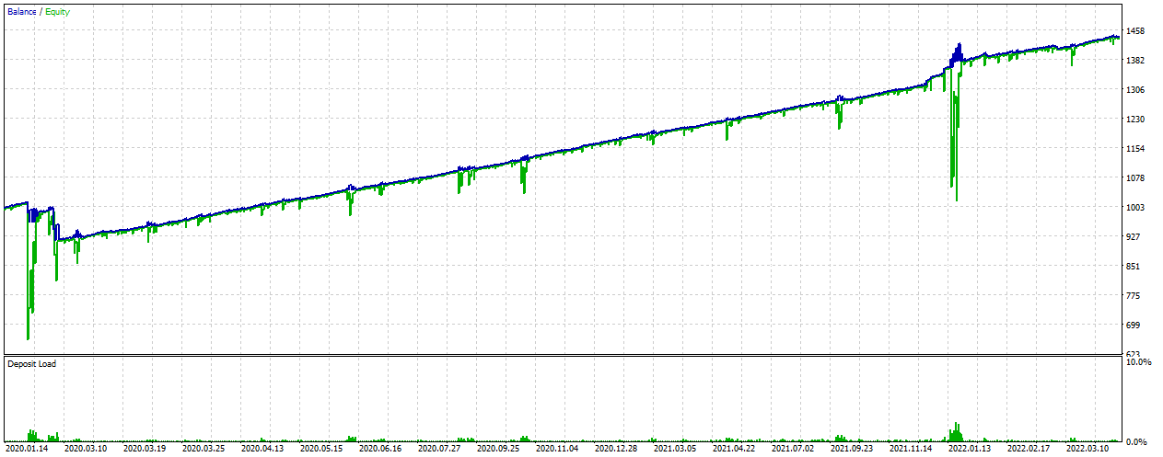
US500 2020.01 – 2022 YTD
0.05

Slide 4
US500 2020.01 – 2022 YTD
0.05

Slide 5
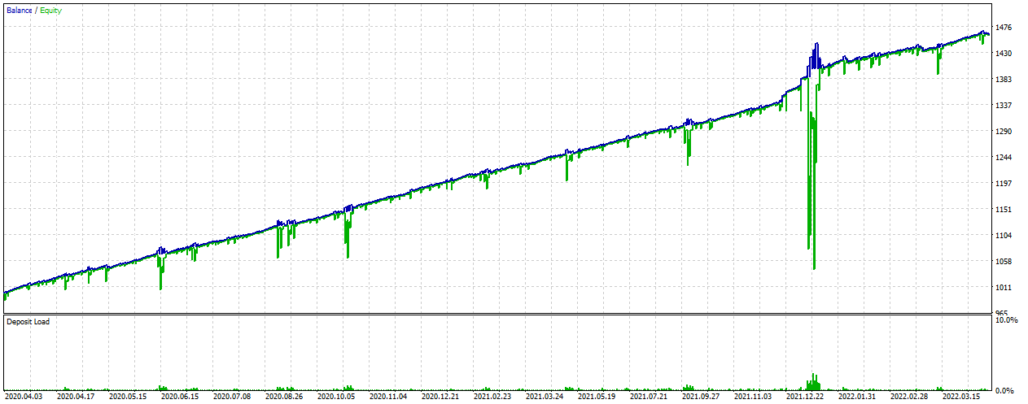
US500 2020.04 – 2022 YTD
0.05

Slide 6
US500 2020.04 – 2022 YTD
0.05

Slide 7
US500 v6
Exness

Slide 8
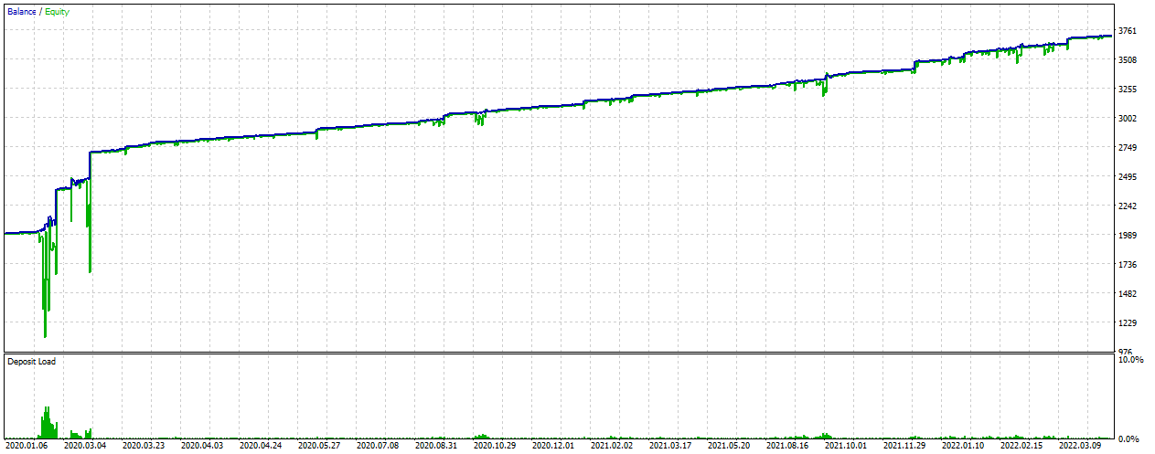
US500 2020.01 – 2022 YTD
0.03

Slide 9
US500 2020.01 – 2022 YTD
0.03

Slide 10
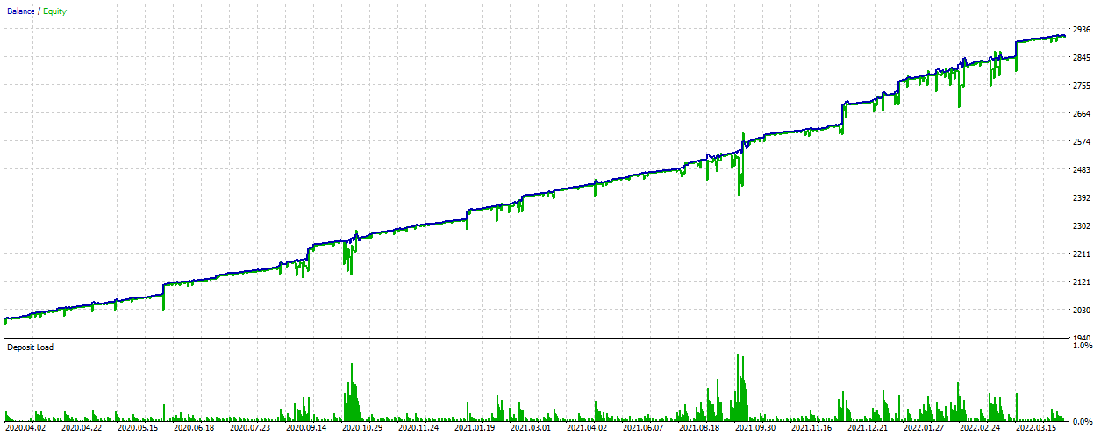
US500 2020.04 – 2022 YTD
0.03

Slide 11
US500 2020.04 – 2022 YTD
0.03

