Slide 1
Global Indexes
Community Power

Slide 2
Bra50 v2
ActivTrades

Slide 3
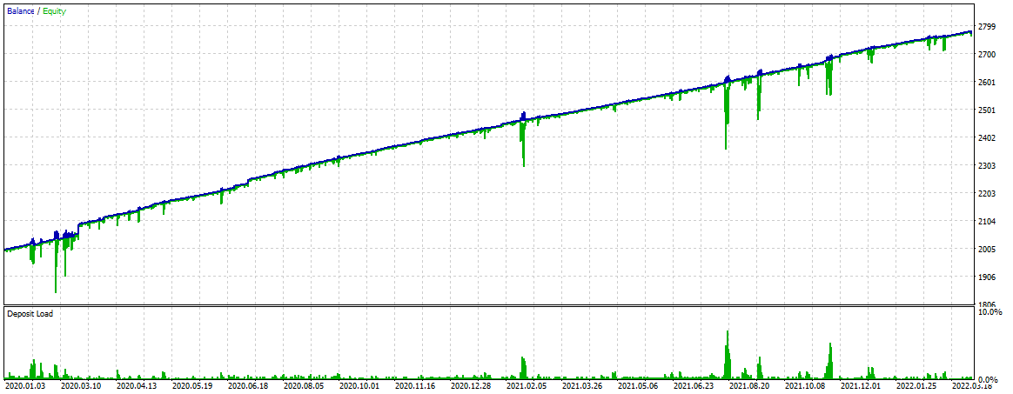
Bra50 2020.01 – 2022 YTD
0.05 lot

Slide 4
Bra50 2020.01 – 2022 YTD
0.05 lot

Slide 5
Bra50 v3
ActivTrades

Slide 6
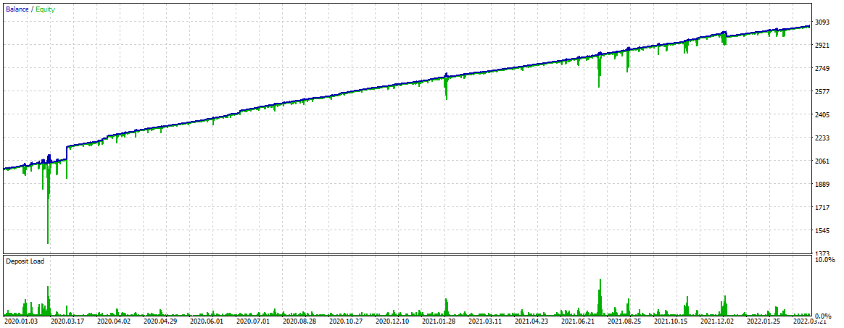
Bra50 2020.01 – 2022 YTD
0.05 lot

Slide 7
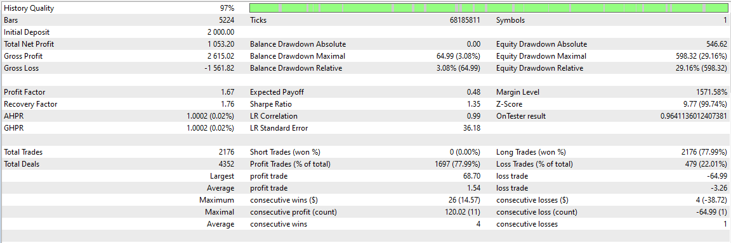
Bra50 2020.01 – 2022 YTD
0.05 lot

