Slide 1
Global Indexes
Community Power

Slide 2
Fr40 v4
Exness

Slide 3
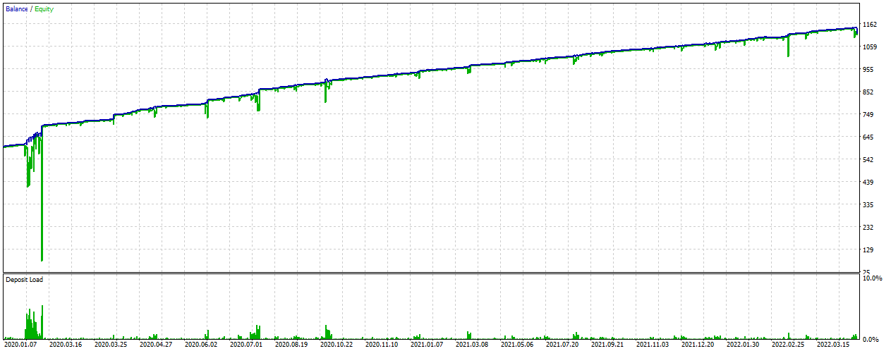
Fr40 2020.01 – 2022 YTD
0.01 lot

Slide 4
Fr40 2020.01 – 2022 YTD
0.01 lot

Slide 5
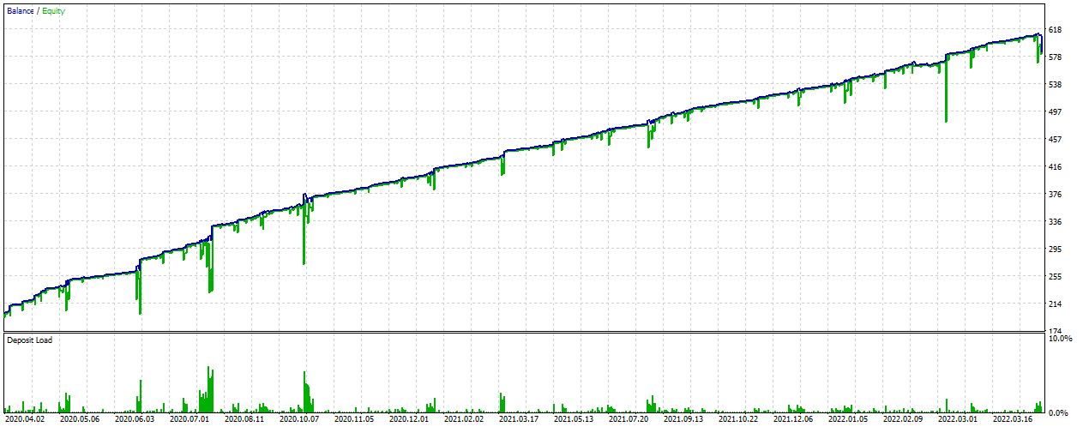
Fr40 2020.04 – 2022 YTD
0.01 lot

Slide 6
Fr40 2020.04 – 2022 YTD
0.01 lot

