Slide 1
Global Indexes
Community Power

Slide 2
Stoxx50 v1
Exness

Slide 3
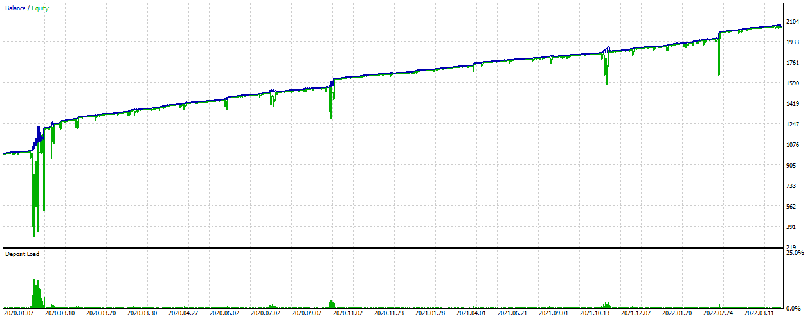
Stoxx50 2020.01 – 2022 YTD
0.01 lot

Slide 4
Stoxx50 2020.01 – 2022 YTD
0.01 lot

Slide 5
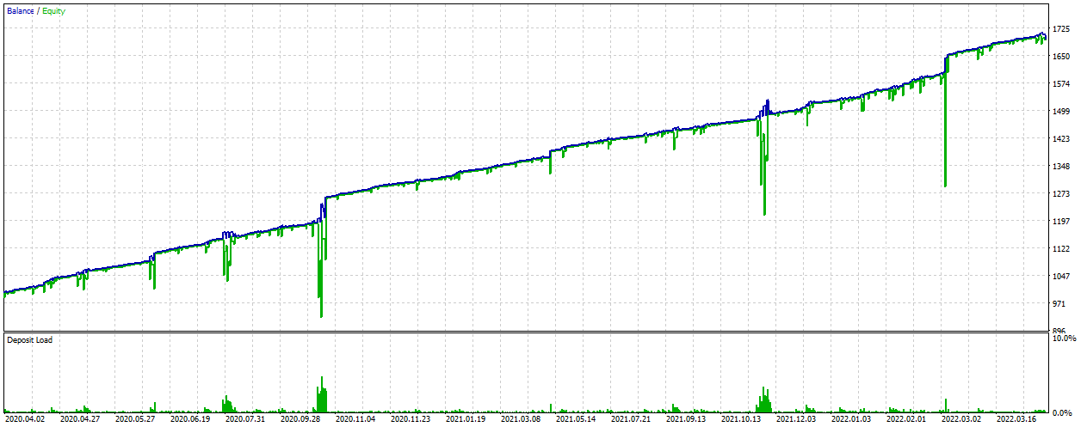
Stoxx50 2020.04 – 2022 YTD
0.01 lot

Slide 6
Stoxx50 2020.04 – 2022 YTD
0.01 lot

