Slide 1

Global Indexes
Community Power

Slide 2
USTec v4
Exness

Slide 3
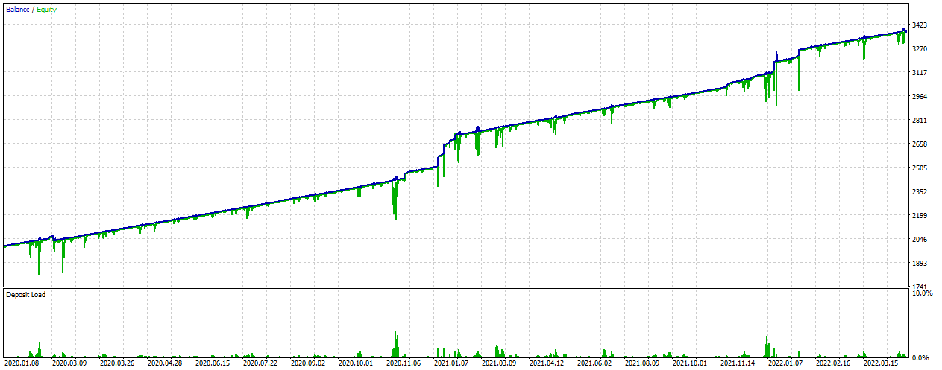
USTec 2020.01 – 2022 YTD
0.01

Slide 4
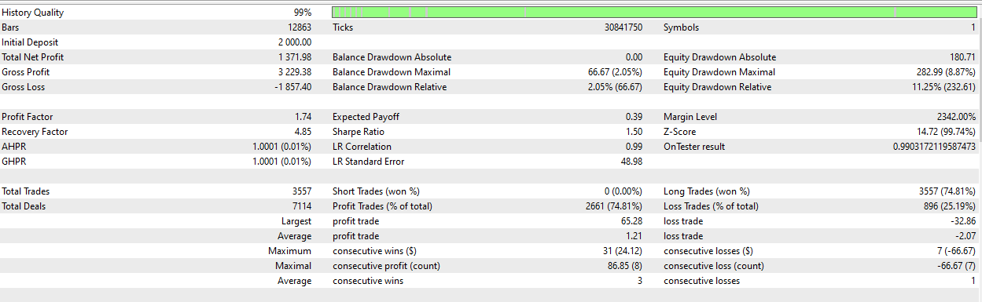
USTec 2020.01 – 2022 YTD
0.01

Slide 5
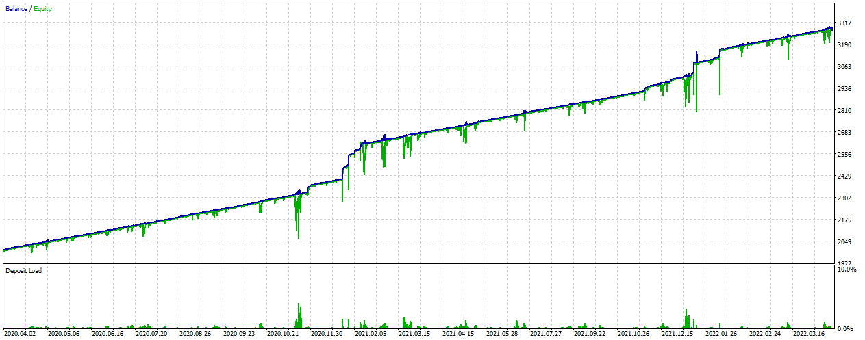
USTec 2020.04 – 2022 YTD
0.01

Slide 6
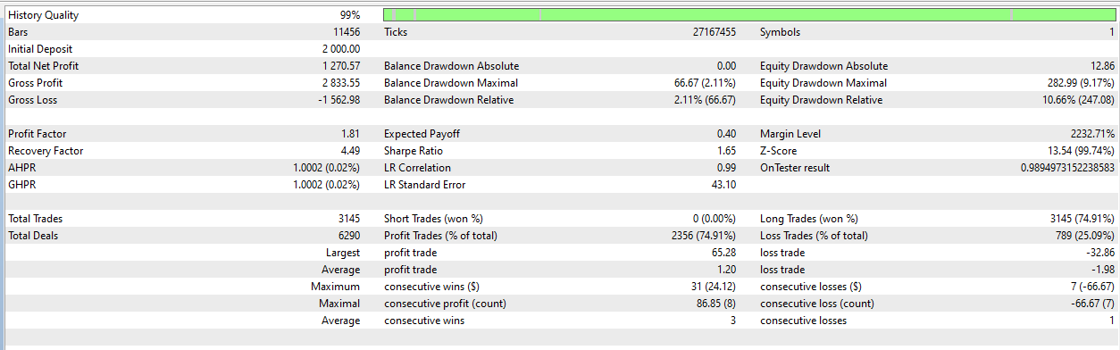
USTec 2020.04 – 2022 YTD
0.01

Slide 7
USTec v5
Exness

Slide 8
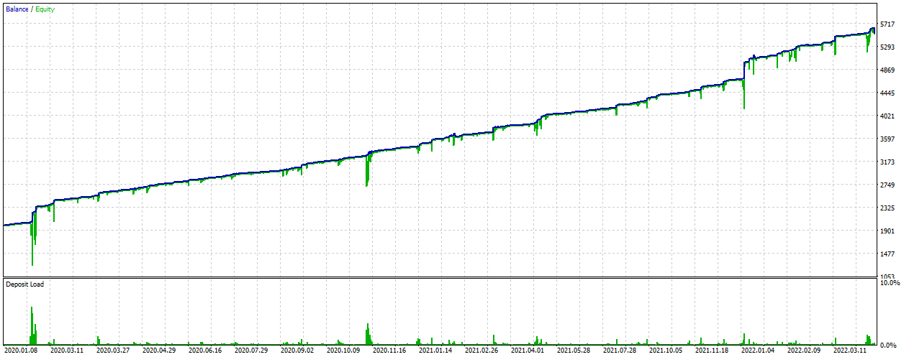
USTec 2020.01 – 2022 YTD
0.01

Slide 9
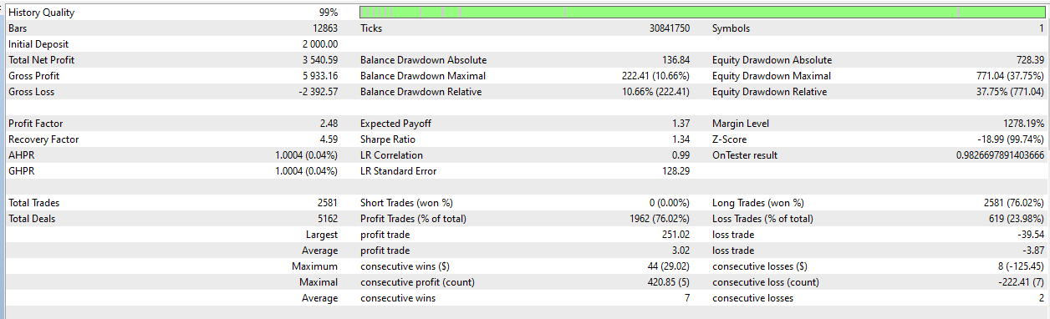
USTec 2020.01 – 2022 YTD
0.01

Slide 10
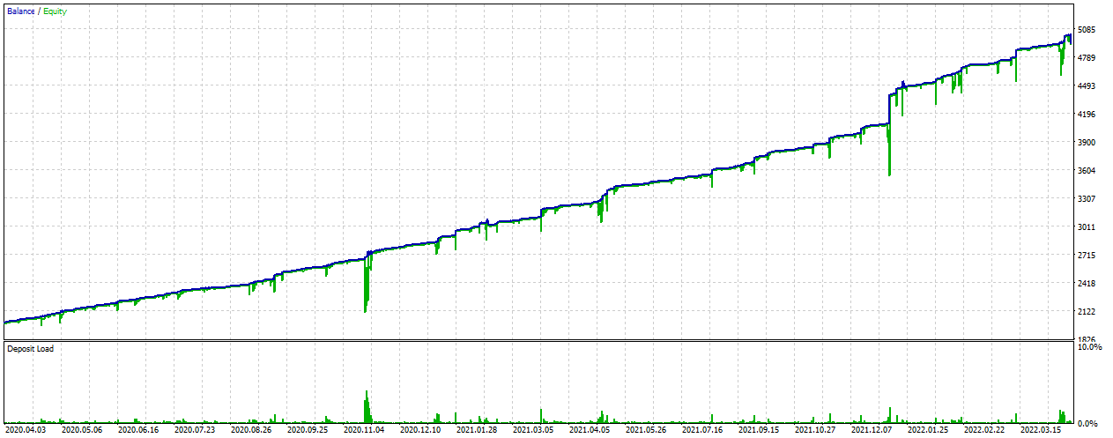
USTec 2020.04 – 2022 YTD
0.01

Slide 11
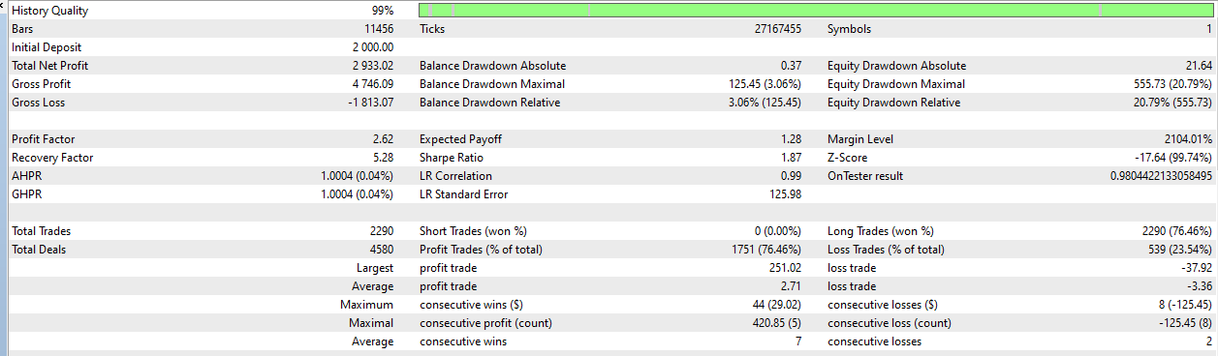
USTec 2020.04 – 2022 YTD
0.01

Slide 12
USTec v6 Aggressive
Exness

Slide 13
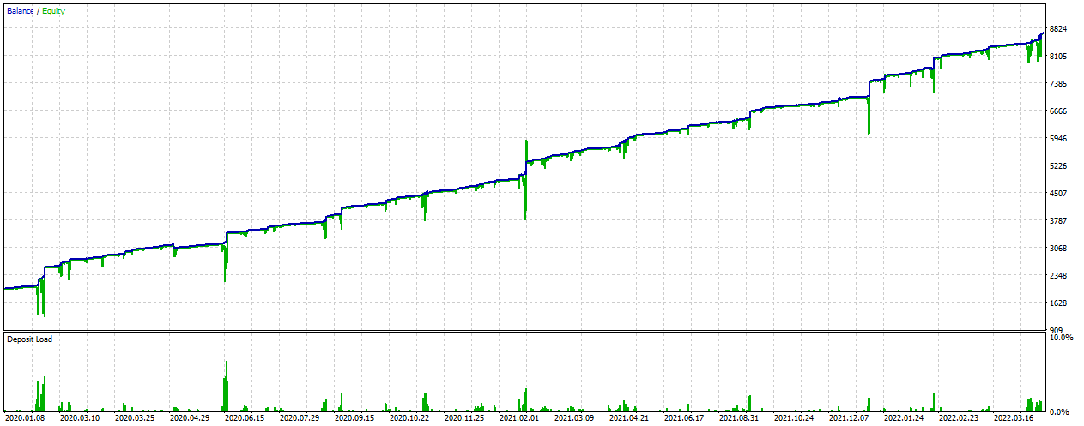
USTec 2020.01 – 2022 YTD
0.01

Slide 14
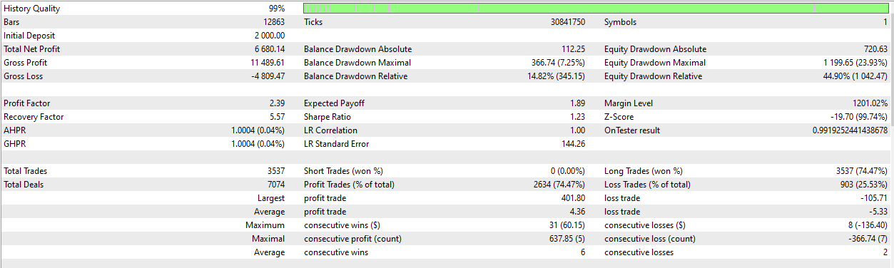
USTec 2020.01 – 2022 YTD
0.01

Slide 15
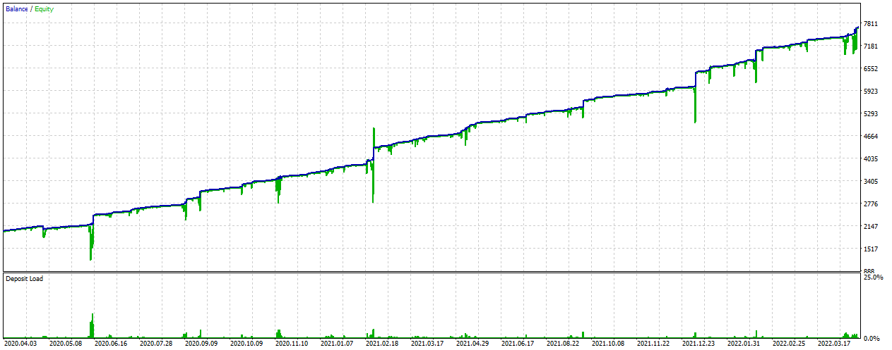
USTec 2020.04 – 2022 YTD
0.01

Slide 16

USTec 2020.04 – 2022 YTD
0.01

Slide 17
USTec v7
Exness

Slide 18
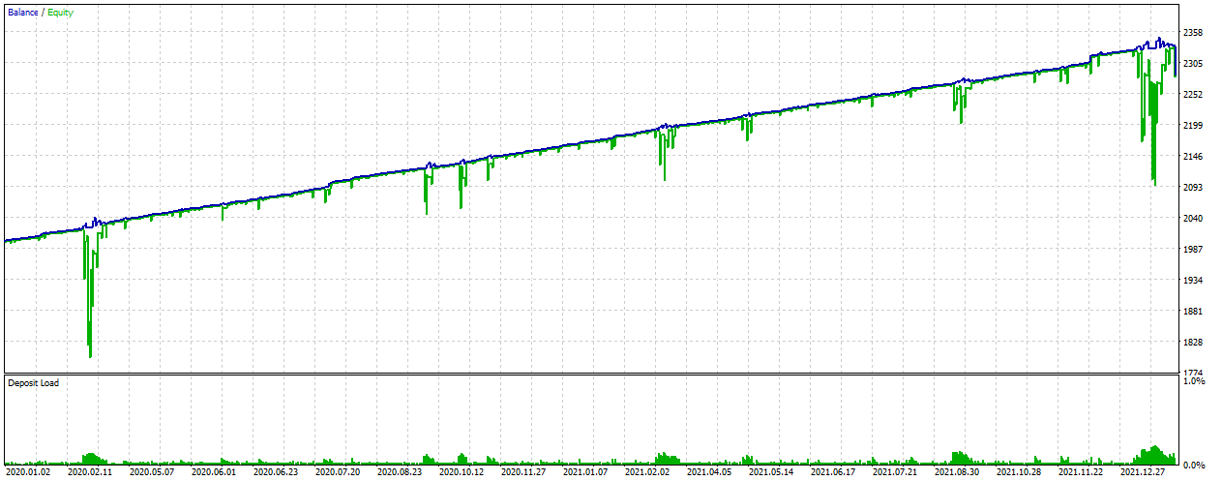
USTec 2020.01 – 2022 YTD
0.01

Slide 19

USTec 2020.01 – 2022 YTD
0.01

Slide 20
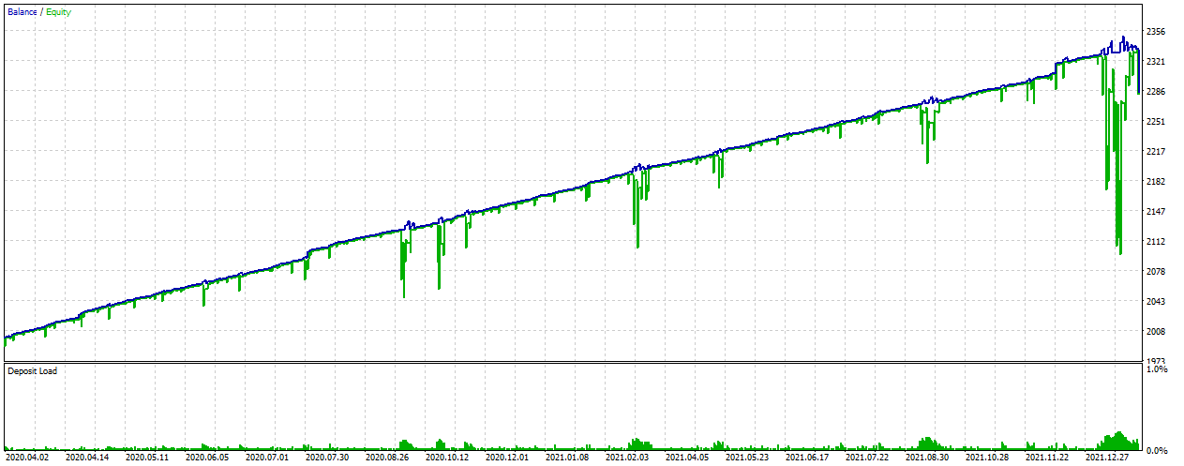
USTec 2020.04 – 2022 YTD
0.01

Slide 21

USTec 2020.04 – 2022 YTD
0.01

Slide 22
USTec v8
Exness

Slide 23
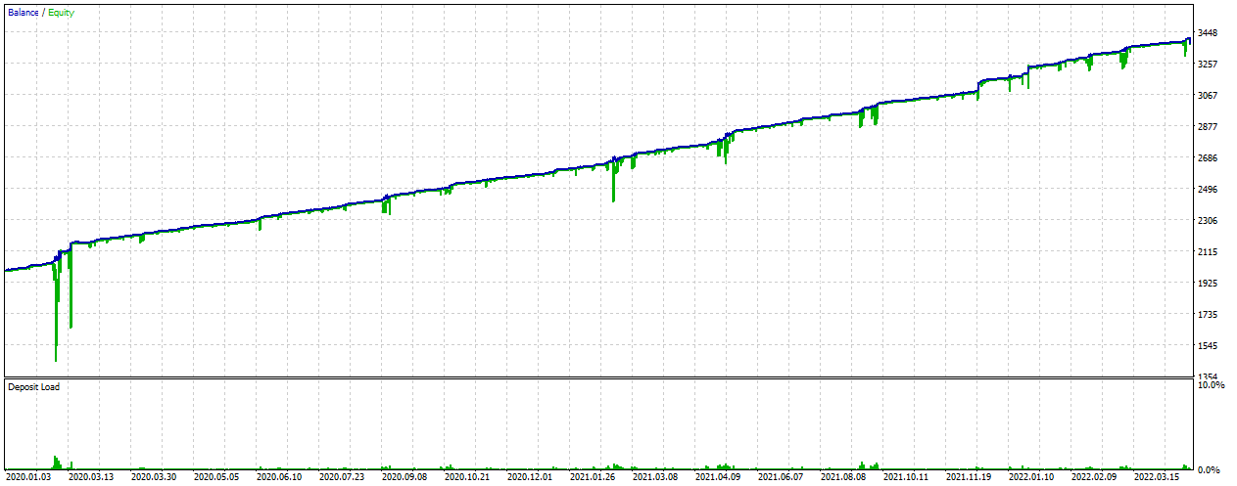
USTec 2020.01 – 2022 YTD
0.01

Slide 24

USTec 2020.01 – 2022 YTD
0.01

Slide 25
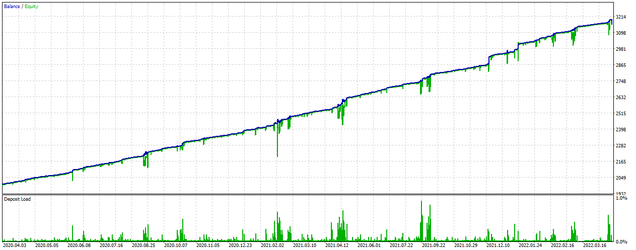
USTec 2020.04 – 2022 YTD
0.01

Slide 26
USTec 2020.04 – 2022 YTD
0.01

Slide 27
USTec v9 Ultra Conservative
Exness

Slide 28
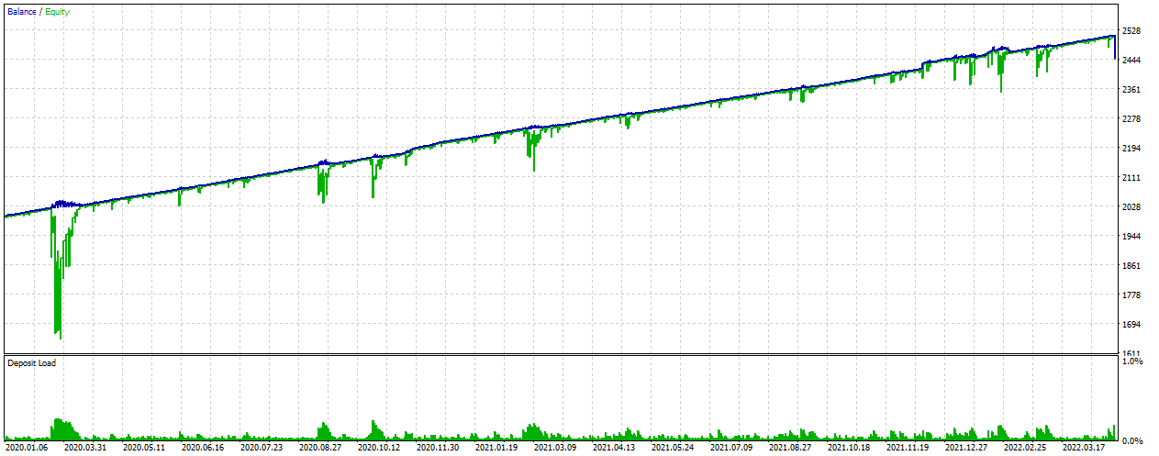
USTec 2020.01 – 2022 YTD
0.01

Slide 29
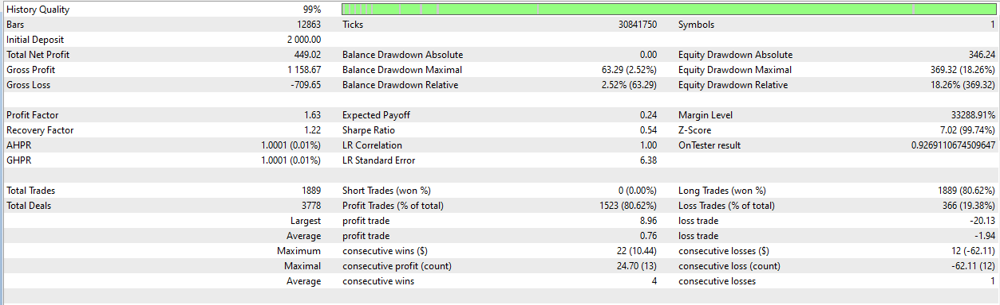
USTec 2020.01 – 2022 YTD
0.01

Slide 30
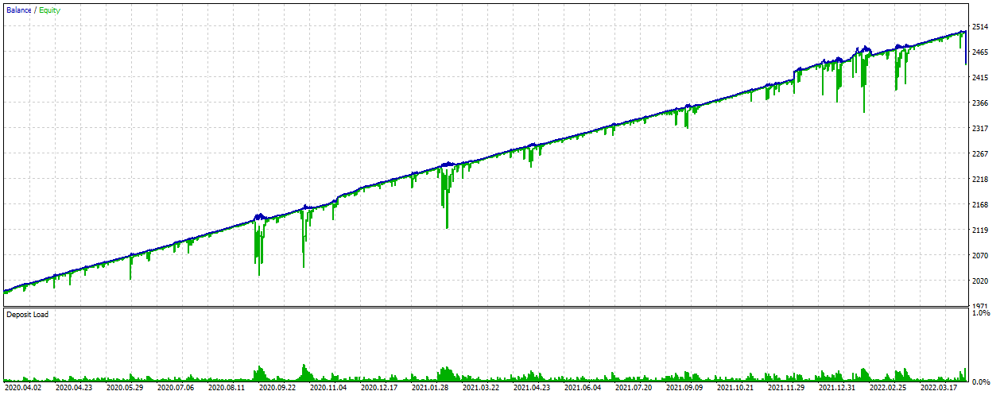
USTec 2020.04 – 2022 YTD
0.01

Slide 31

USTec 2020.04 – 2022 YTD
0.01

Slide 32
USTec v10 Moderate
Exness

Slide 33
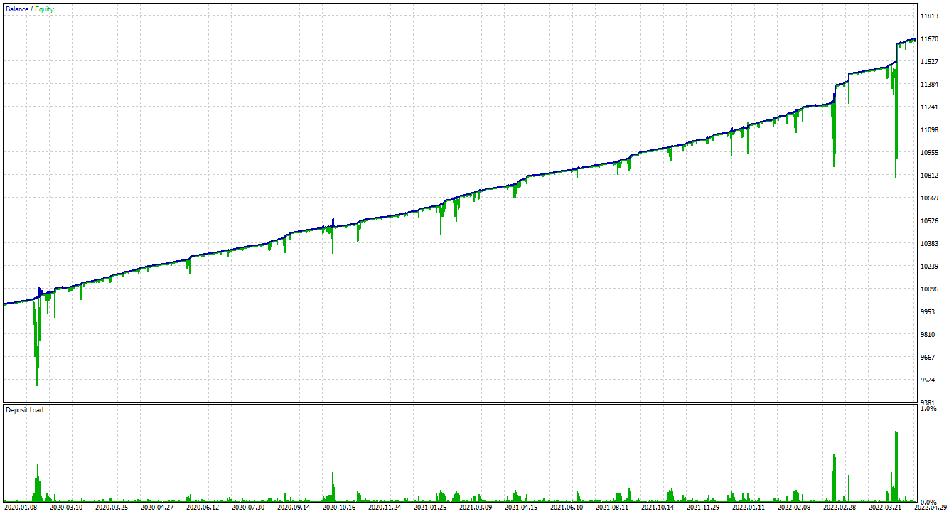
USTec 2020.01 – 2022 YTD
0.01

Slide 34
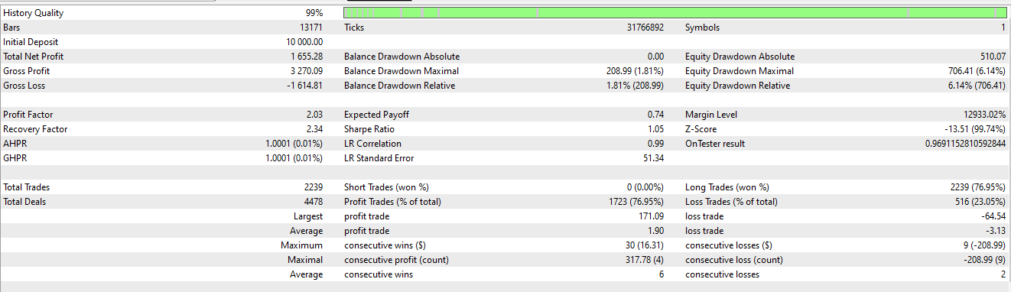
USTec 2020.01 – 2022 YTD
0.01

Slide 35
USTec v11 Conservative
Exness

Slide 36
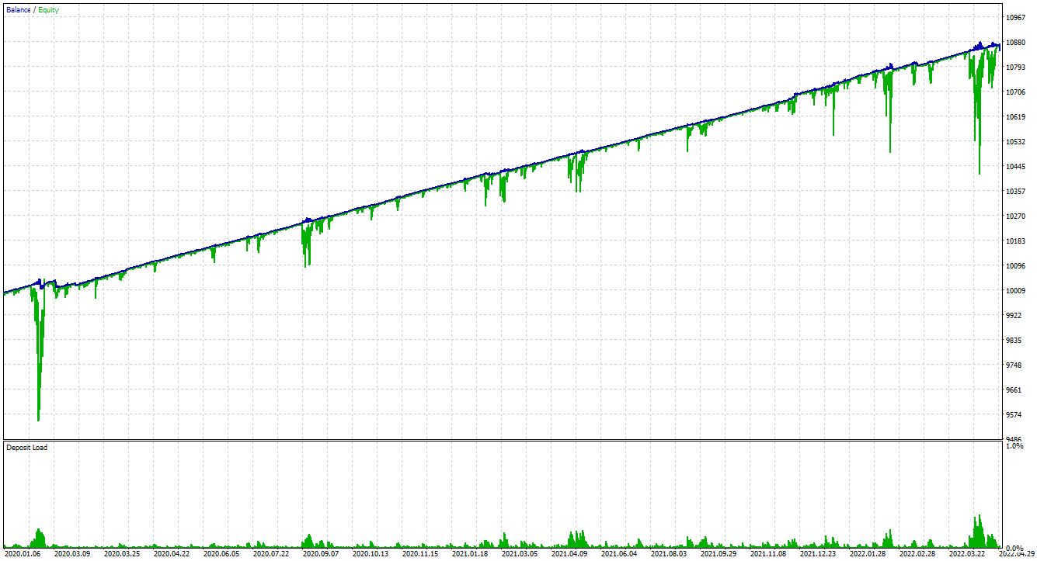
USTec 2020.01 – 2022 YTD
0.01

Slide 37

USTec 2020.01 – 2022 YTD
0.01

